Slide 1

Heredity and Evolution
Speciation

Slide 2

Now, lets understand the process of formation of species on earth

Slide 3

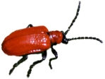

Speciation
What we have seen so far is micro-evolution.
The changes were naturally selected and they simply change the common characteristics of species
That means that the changes are small, even though they are significant.
But this does not properly explain how new species come into existence.

Slide 4


Lets see how new species come into existence

Slide 5
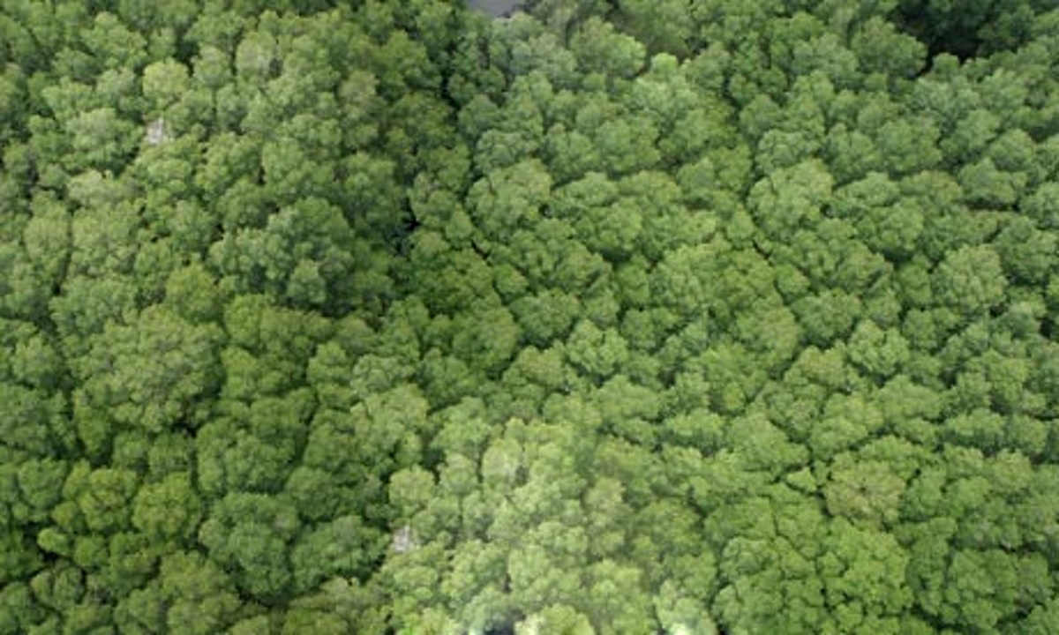
Speciation
If the bushes the beetles feed on, are
spread widely over a mountain range.

Slide 6
Speciation
The beetle population becomes
very large
But individual beetles feed mostly on a few nearby
bushes throughout their lifetime.

Slide 7
Speciation
They do not travel far. So, in this huge
population of beetles, there will be
sub-populations in neighbourhoods.
Male and female beetles have to meet for reproduction to happen, most reproduction will be within these sub-populations.
neighborhoods.

Slide 8
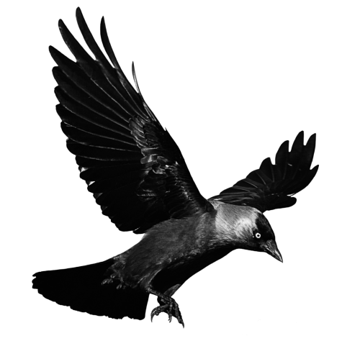

Speciation
neighborhoods.
But occasional beetle is picked up by a crow from one site and dropped in the other site
without being eaten.
This will result in the genes of the migrant
beetle entering a new population.
The migrant beetle will reproduce
with the local population.
But populations are partly, but not completely separated. So, separate species can not be formed.

Slide 9
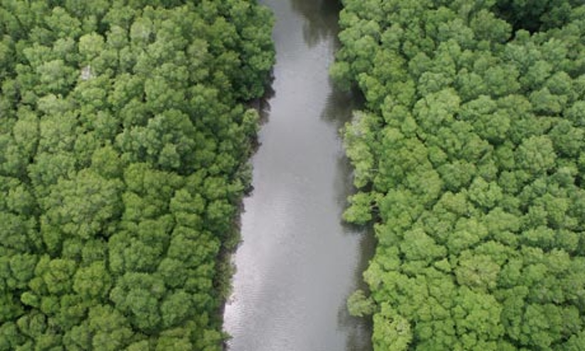
Speciation
If a large river
comes into existence between the bushes.

Slide 10
Speciation
The gene flow between them will decrease even further.
neighborhoods.
The two populations will be further isolated.
The two populations will be further isolated.
Together, the processes of genetic drift and natural selection will result in these two isolated sub-populations of beetles becoming more and more different from each other.
Members of these two groups will be incapable of reproducing with each other even if they happen to meet.
Hence new species of beetles are generated.
Over generations, genetic drift will accumulate different changes in each sub-population.
Natural selection may also operate differently
in these different geographic locations.

Slide 11
Thank You

